Slide 1


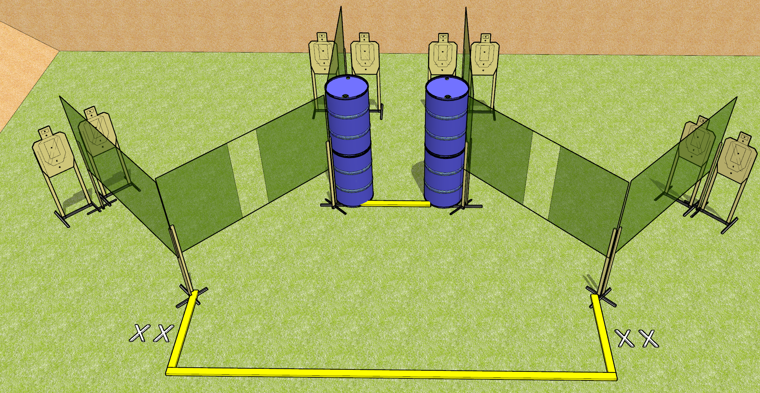
 | Dothan Gun Club – USPSA Match Deja Vu Course Designer : Drew Coleman
START POSITION : Standing with both feet on X’s, wrists above shoulders
GUN READY CONDITION : Pistol loaded and holstered. PCC loaded, held with both hands, safety on, stock on belt. |  | SCORING: Comstock, 24 rounds TARGETS: 8 paper, 0 Steel SCORED HITS: Best 3 on paper, steel until down START-STOP: Audible, last shot RULES:
STAGE PROCEDURE: Engage targets as they become available from within the fault lines.

Slide 2
Deja Vu
Written Stage Briefing
Deja Vu is a 24 round, 120 point, Comstock field course. There are eight USPSA targets. The best two hits on paper will score. The start signal is audible.
Handgun start position is standing on either set of X’s, wrists above shoulders. Handgun is loaded and holstered.
PCC start position is standing on either set of X’s. Loaded carbine is held with both hands, stock on belt, safety on.
On start signal, engage targets as they become available from within the shooting area.

